Slide 1
Istio
Traffic Management

Slide 2
Demo App
gs
login
gs
shipping
gs
queue
sched
split
gs
front-end
gs
catalogue
gs
cart
gs
cart-db
split
split
gs
orders
gs
orders-db
gs
payment
split
gs
accounts
gs
accounts-db
split

Slide 3


Simul-shop
SCHED_CALL_INTERVAL
SCHED_CALL_URL_LST
login
shipping
queue
front-end
catalogue
cart
cart-db
SPLIT_CALL_URL_LST
SPLIT_CALL_URL_LST
payment
orders
accounts-db
SPLIT_CALL_URL_LST
accounts

Slide 4







Simul-shop
pegasus-pay
Workload Entry
ingress
pegasus
Legacy System

Slide 5
Simul-shop
login
shipping
queue
front-end
catalogue
cart
cart-db
orders
payment
pegasus-pay
Workload Entry
accounts-db
accounts

Slide 6


SCHED_CALL_INTERVAL
SCHED_CALL_URL_LST
front-end
backend
SPLIT_CALL_URL_LST

Slide 7
Traffic management
cluster
istio-system
your-namespace
my-pod
my-pod2
my-container
my-container
PODs
istio-ingressgateway
my-service
envoy
envoy
LB
istio-ingressgateway
Service
istio-egressgateway
istio-egressgateway
pod
service
container

Slide 8
Configuration
cluster
istio-system
your-namespace
Destination Rules
PODs
L7
istio-ingressgateway
Virtual Services
Services
LoadBalancer
istio-ingressgateway
Service Entries
Gateway
(ingress/egress)
istio-egressgateway
L4-L6
Service
istio-ingressgateway
another-namespace
Gateway
Egress Gateways

Slide 9
Envoy
virtual_hosts: *
routes: prefix / -> rewrite: www.googe.com
listeners
clusters
Address: 0.0.0.0:10000
endpoints: www.google.com:443

Slide 10


Slide 11
Gateway
apiVersion: networking.istio.io/v1alpha3
kind: Gateway
metadata:
name: bookinfo-gateway
spec:
selector:
istio: ingressgateway # use istio default controller
servers:
- port:
number: 80
name: http
protocol: HTTP
hosts:
- "*"
port
istio-ingressgateway
servers
hosts
selector
istio-egressgateway
tls
kubectl get pod -l istio=ingressgateway -n istio-system
kubectl get pod -l istio=egressgateway -n istio-system
kubectl get gateway/bookinfo-gateway –o yaml

Slide 12
VirtualService
apiVersion: networking.istio.io/v1alpha3
kind: VirtualService
metadata:
name: reviews
spec:
hosts:
- reviews
http:
- match:
- headers:
end-user:
exact: jason
route:
- destination:
host: reviews
subset: v2
- route:
- destination:
host: reviews
subset: v3
tcp
http
Header.Host == reviews
gRPC
Match
Headers.end-user == jason
review
v2
route
review
v3
kubectl get VirtualService -n k360api
kubectl get VirtualService/k360api -n k360api -o yaml

Slide 13
DestinationRule
subsets
labels
apiVersion: networking.istio.io/v1alpha3
kind: DestinationRule
metadata:
name: reviews
spec:
host: reviews
subsets:
- name: v1
labels:
version: v1
- name: v2
labels:
version: v2
- name: v3
labels:
version: v3
v1
version: v1
Host
(ex: service)
v2
version: v2
v3
version: v2
kubectl get DestinationRule -n k360api
kubectl get DestinationRule/k360security -n k360api -o yaml

Slide 14
VirtualService
apiVersion: networking.istio.io/v1alpha3
kind: VirtualService
metadata:
name: reviews
spec:
hosts:
- reviews
http:
- route:
- destination:
host: reviews
subset: v1
weight: 80
- destination:
host: reviews
subset: v2
weight: 20
80%
Reviews
v1
http
Header.Host == reviews
Reviews
v2
20%

Slide 15
ServiceEntry
apiVersion: networking.istio.io/v1alpha3
kind: ServiceEntry
metadata:
name: googleapis
spec:
hosts:
- www.googleapis.com
ports:
- number: 80
name: http
protocol: HTTP
- number: 443
name: https
protocol: HTTPS
resolution: DNS
hosts
ports
resolution
kubectl get ServiceEntry
Kubectl get ServiceEntry/xxx –o yaml

Slide 16







CLI ou API
Controle
istiod
Dados
istio-proxy
istio-proxy
aplicação
aplicação
POD A
POD B
Métricas
Rastreamento

Slide 17






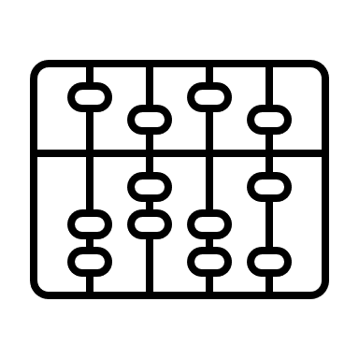
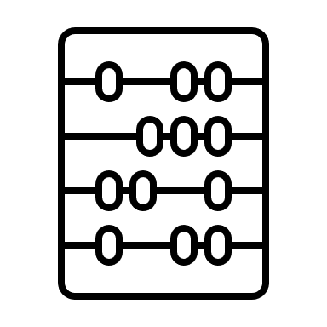






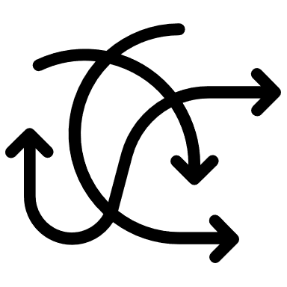
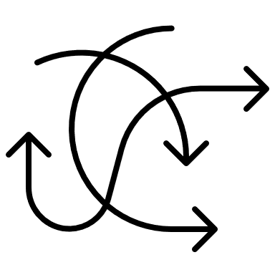



































Slide 18













































Slide 19























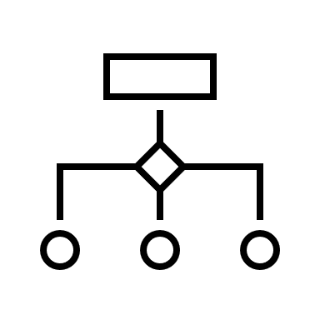





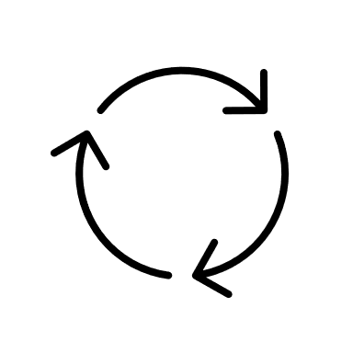


Slide 20
CLI ou API
Controle
istiod
Dados
istio-proxy
istio-proxy
aplicação
aplicação
POD A
POD B
Métricas
Rastreamento

Slide 21






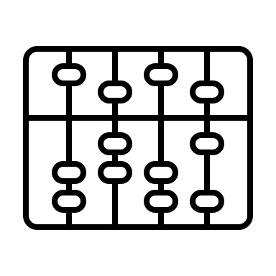
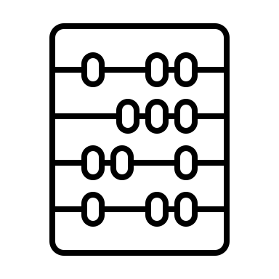






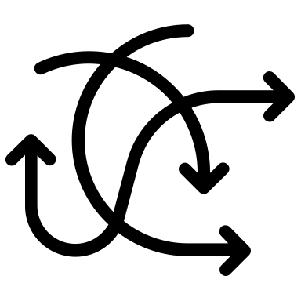
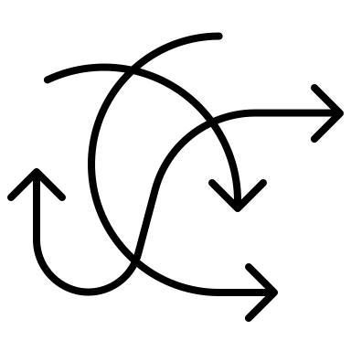



































Slide 23



























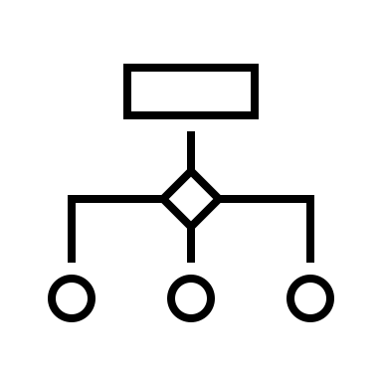




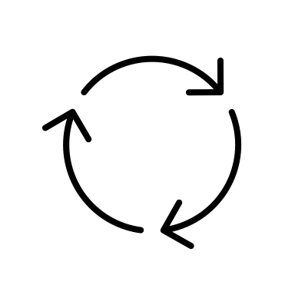

➤✓⏎↩︎⇢↑⇡↓⇣←⇠→⇢⎇☇

Slide 24



































Slide 25
Rota baseada no caminho
https://www.simul-shop/login
login
front-end
https://www.simul.shop.com/shipping/api
https://www.simul.shop.com/orders
orders
shipping

Slide 26
Implantação canário
90%
v1
cliente
incremento
Teste
Sucesso
100% sucesso
10%
v2

Slide 27
Balanceamento de carga com serviços do k8s
POD_A
replicas=9
label
app=front-end
90%
Service
selector app=front-end
balance
POD_B
replicas=1
label
app=front-end
10%

Slide 28
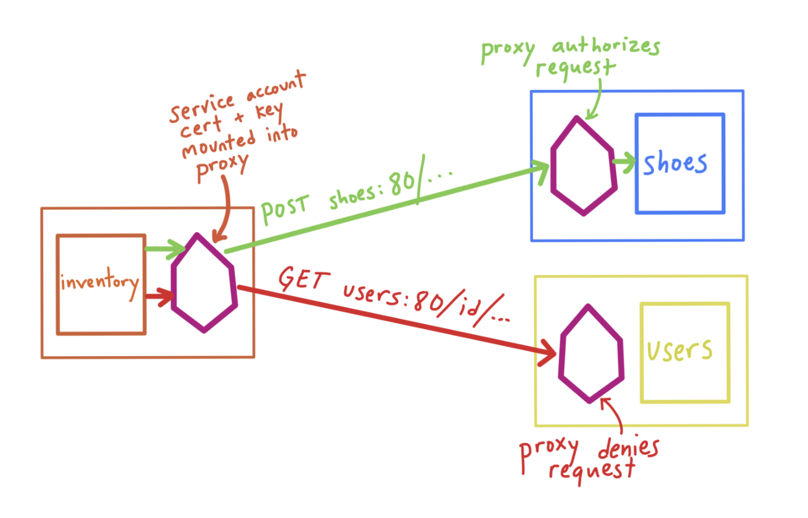
Rota baseada em URI
order
GET
GET
front-end
GET
catalogue

Slide 29
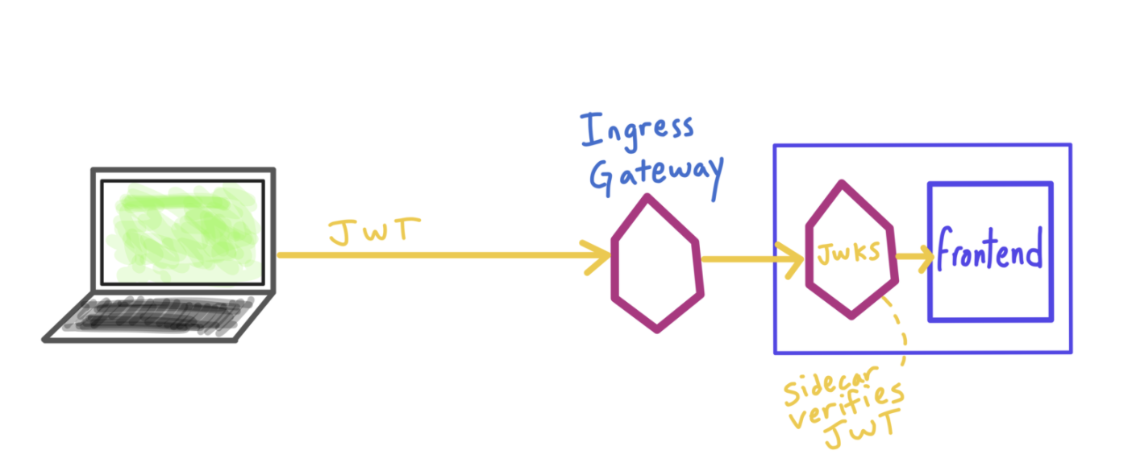

JWT Auth
TOKEN
Login
Ingress Gateway
Valida
token

Slide 30



Retries
5xx
front-end
Login
3 retries
2s each

Slide 31
Retries
5xx
front-end
Login
3 retries
2s each

Slide 32
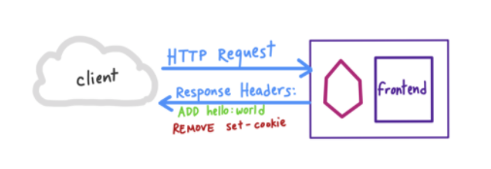
Managing headers
default
front-end
v1
add header
no header
user-region: other
Ingress Gateway
user-region: Southeast
front-end
v2

Slide 33
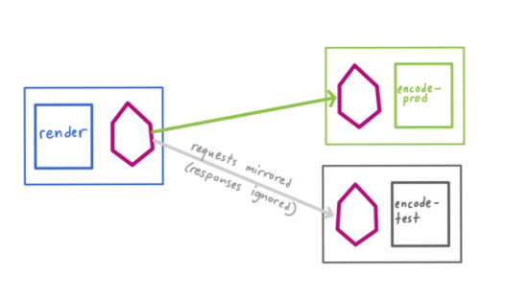

Espelhamento
orders
v1
front-end
orders
v2
request →
← response (ignored)

Slide 34


Disjuntores
catalogue
< threshold →
← > threshold (5xx)

Slide 35

CLI ou API
CLI ou API
ingress-gateway
vs/ds
svc
30008
svc
80
istio-proxy
istio-proxy
vs/ds
istio-proxy
istio-proxy
vs/ds
app=A
version=v1
app=A
version=v2
app=A
version=v1
app=A
version=v2
POD A
POD B
POD A
POD B

Slide 36
mesh
Port 80
istio-proxy
egress-gateway
external API
Port 8000
credit.financial
app=sleep
client
http://credit.financial

